Slide 1
Digital Design & Computer Arch. Lecture 8: Timing and Verification
Prof. Onur Mutlu
ETH Zürich
Spring 2020
13 March 2020

Slide 2
Required Readings (This Week)
Hardware Description Languages and Verilog
H&H Chapter 4 in full
Timing and Verification
H&H Chapters 2.9 and 3.5 + (start Chapter 5)
By tomorrow, make sure you are done with
P&P Chapters 1-3 + H&H Chapters 1-4

Slide 3
Required Readings (Next Week)
Von Neumann Model, LC-3, and MIPS
P&P, Chapter 4, 5
H&H, Chapter 6
P&P, Appendices A and C (ISA and microarchitecture of LC-3)
H&H, Appendix B (MIPS instructions)
Programming
P&P, Chapter 6
Recommended: Digital Building Blocks
H&H, Chapter 5

Slide 4
What Will We Learn Today?
Timing in combinational circuits
Propagation delay and contamination delay
Glitches
Timing in sequential circuits
Setup time and hold time
Determining how fast a circuit can operate
Circuit Verification
How to make sure a circuit works correctly
Functional verification
Timing verification

Slide 5
Tradeoffs in Circuit Design

Slide 6
Circuit Design is a Tradeoff Between:
Area
Circuit area is proportional to the cost of the device
Speed / Throughput
We want faster, more capable circuits
Power / Energy
Mobile devices need to work with a limited power supply
High performance devices dissipate more than 100W/cm²
Design Time
Designers are expensive in time and money
The competition will not wait for you

Slide 7

Requirements and Goals Depend On Application

Slide 8
Circuit Timing
Until now, we investigated logical functionality
What about timing?
How fast is a circuit?
How can we make a circuit faster?
What happens if we run a circuit too fast?
A design that is logically correct can still fail because of real-world implementation issues!

Slide 9
Part 1: Combinational Circuit Timing

Slide 10
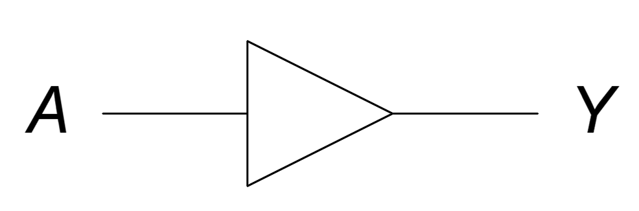
Digital Logic Abstraction
“Digital logic” is a convenient abstraction
Output changes immediately with the input
A
1
0
Y
0
1

Slide 11
Combinational Circuit Delay
In reality, outputs are delayed from inputs
Transistors take a finite amount of time to switch
time

Slide 12
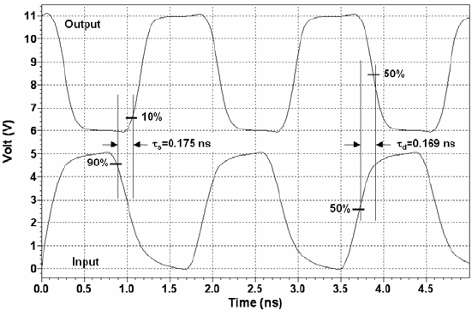
Real Inverter Delay Example
Image source: Sandoval-Ibarra, F., and E. S. Hernández-Bernal. "Ring CMOS NOT-based oscillators: Analysis and design." Journal of applied research and technology, 2008.

Slide 13
Circuit Delay and Its Variation
Delay is fundamentally caused by
Capacitance and resistance in a circuit
Finite speed of light (not so fast on a nanosecond scale!)
Anything affecting these quantities can change delay:
Rising (i.e., 0 -> 1) vs. falling (i.e., 1 -> 0) inputs
Different inputs have different delays
Changes in environment (e.g., temperature)
Aging of the circuit
We have a range of possible delays from input to output

Slide 14
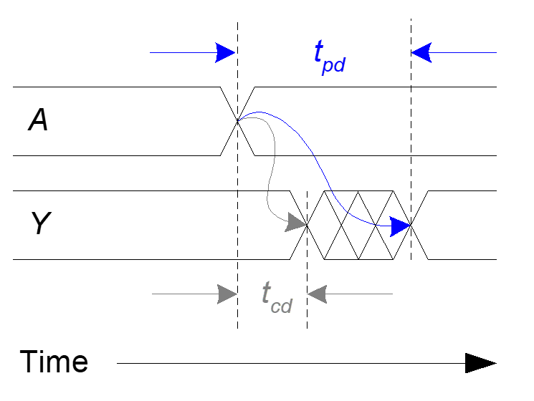
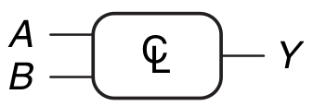
Delays from Input to Output
Contamination delay (t_{cd}): delay until Y starts changing
Propagation delay (t_{pd}): delay until Y finishes changing
Example Circuit
Effect of Changing Input ‘A’
Cross-hatching
means value is changing

Slide 15
Calculating Long/Short Paths
We care about both the longest and shortest paths in a circuit (we will see why later in the lecture)
Critical (Longest) Path: t_{pd} = 2 t_{pd_AND} + t_{pd_OR}
Shortest Path: t_{cd} = t_{cd_AND}

Slide 16
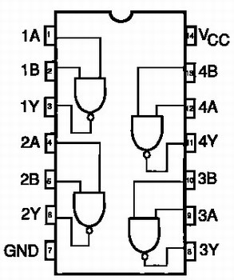
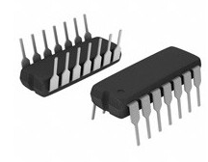
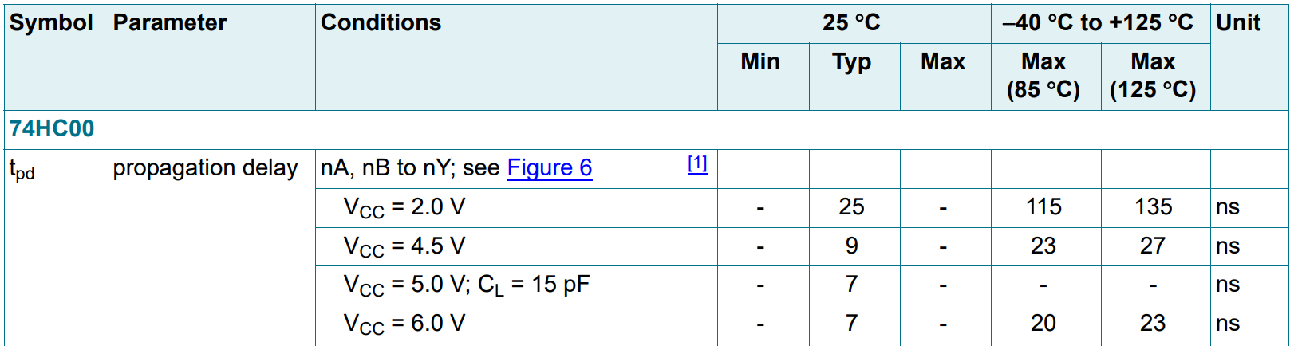
Example t_{pd} for a Real NAND-2 Gate
Heavy dependence on voltage and temperature!
Source: Nexperia 2-input NAND (74HC00) Datasheet, Section 10

Slide 17
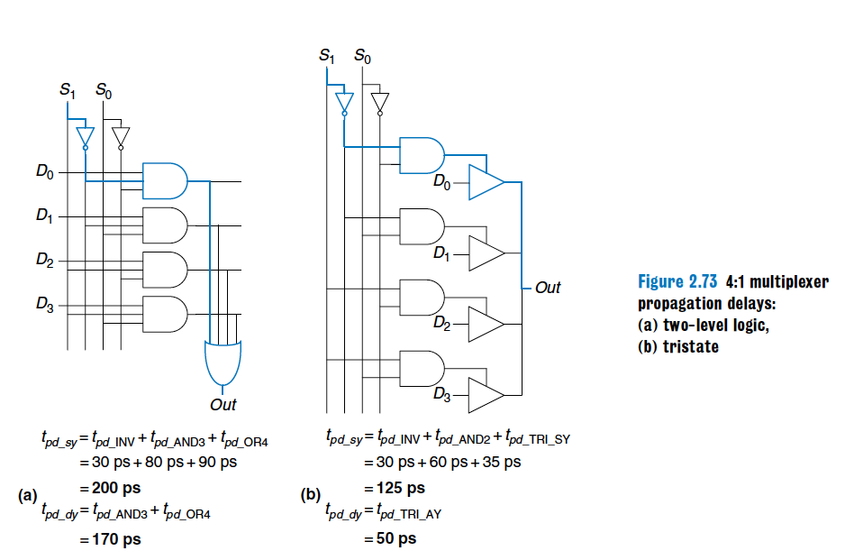
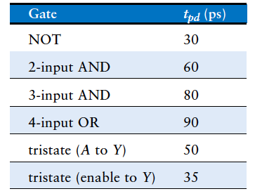
Example Worst-Case t_{pd}
Two different implementations of a 4:1 multiplexer
Gate Delays
Implementation 1
Implementation 2
Different designs lead to very different delays

Slide 18
Disclaimer: Calculating Long/Short Paths
It’s not always this easy to determine the long/short paths!
Not all input transitions affect the output
Can have multiple different paths from an input to output
In reality, circuits are not all built equally
Different instances of the same gate have different delays
Wires have nonzero delay (increasing with length)
Temperature/voltage affect circuit speeds
Not all circuit elements are affected the same way
Can even change the critical path!
Designers assume “worst-case” conditions and run many statistical simulations to balance yield/performance

Slide 19
Combinational Timing Summary
Circuit outputs change some time after the inputs change
Caused by finite speed of light (not so fast on a ns scale!)
Delay is dependent on inputs, environmental state, etc.
The range of possible delays is characterized by:
Contamination delay (t_{cd}): minimum possible delay
Propagation delay (t_{pd}): maximum possible delay
Delays change with:
Circuit design (e.g., topology, materials)
Operating conditions

Slide 20
Output Glitches

Slide 21
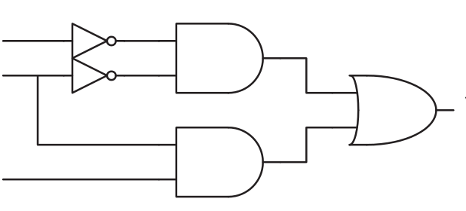
Glitches
Glitch: one input transition causes multiple output transitions
Circuit initial state
0
0
1
1

Slide 22
Glitches
Glitch: one input transition causes multiple output transitions
0
1 -> 0
1 -> ?
1

Slide 23
Glitches
Glitch: one input transition causes multiple output transitions
Slow path (3 gates)
0
1 -> 0
1 -> ?
1
Fast path (2 gates)

Slide 24
Glitches
Glitch: one input transition causes multiple output transitions
Slow path (3 gates)
0
1 -> 0
1 -> 0 -> 1
1
Fast path (2 gates)

Slide 25
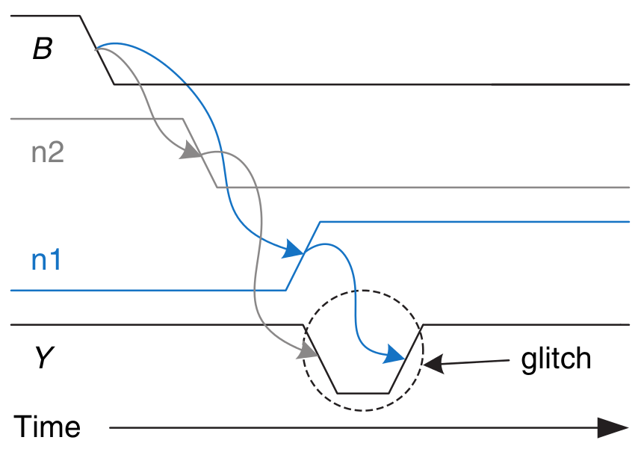
Glitches
Glitch: one input transition causes multiple output transitions
Slow path (3 gates)
0
(B) 1 -> 0
n1
(Y) 1 -> 0 -> 1
n2
1
Fast path (2 gates)

Slide 26
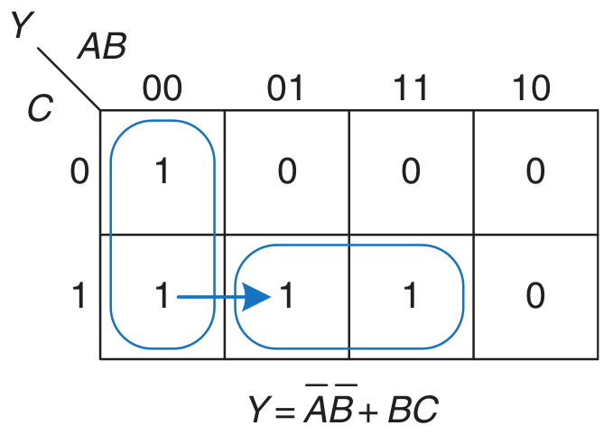
Avoiding Glitches Using K-Maps
Glitches are visible in K-maps
Recall: K-maps show the results of a change in a single input
A glitch occurs when moving between prime implicants
(A) 0
AB
(B) 1 -> 0
(Y) 1 -> 0 -> 1
(C) 1
BC

Slide 27
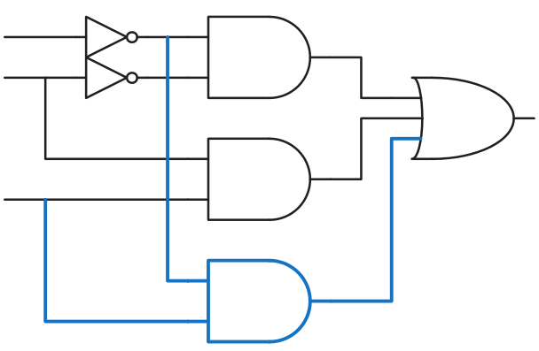
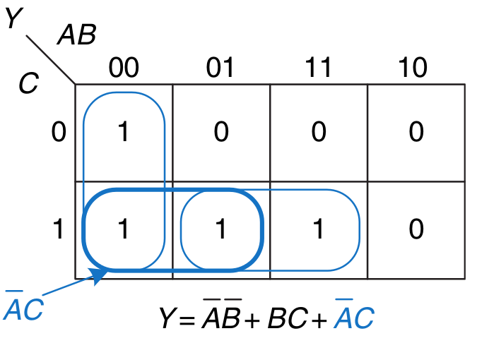
Avoiding Glitches Using K-Maps
We can fix the issue by adding in the consensus term
Ensures no transition between different prime implicants
(A) 0
AB
(B) 1 -> 0
BC
(Y) 1 -> 1
(C) 1
AC
No dependence on B
=> No glitch!

Slide 28
Avoiding Glitches
Q: Do we always care about glitches?
Fixing glitches is undesirable
More chip area
More power consumption
More design effort
The circuit is eventually guaranteed to converge to the right value regardless of glitchiness
A: No, not always!
If we only care about the long-term steady state output, we can safely ignore glitches
Up to the designer to decide if glitches matter in their application

Slide 29
Part 2: Sequential Circuit Timing

Slide 30
Recall: D Flip-Flop
Flip-flop samples D at the active clock edge
It outputs the sampled value to Q
It “stores” the sampled value until the next active clock edge
CLK
D
Q
The D flip-flop is made from combinational elements
D, Q, CLK all have timing requirements!

Slide 31
D Flip-Flop Input Timing Constraints
D must be stable when sampled (i.e., at active clock edge)
CLK
D
Q
Setup time (t_{setup}): time before the clock edge that data must be stable (i.e. not changing)
Hold time (t_{hold}): time after the clock edge that data must be stable
Aperture time (t_{a}): time around clock edge that data must be stable (t_{a} = t_{setup} + t_{hold})

Slide 32
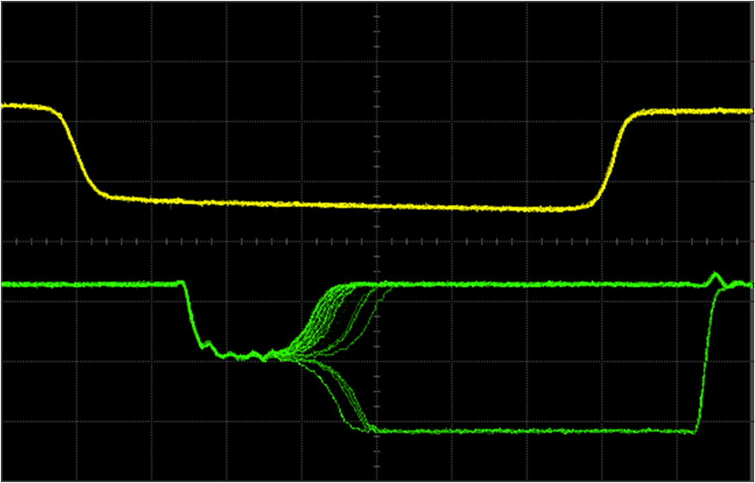
Violating Input Timing: Metastability
If D is changing when sampled, metastability can occur
Flip-flop output is stuck somewhere between ‘1’ and ‘0’
Output eventually settles non-deterministically
Example Timing Violations (NAND RS Latch)
CLK
Q
Non-deterministic Convergence
Metastability
Source: W. J. Dally, Lecture notes for EE108A, Lecture 13: Metastability and Synchronization Failure (When Good Flip-Flops go Bad) 11/9/2005.

Slide 33
Flip-Flop Output Timing
CLK
D
Q
Contamination delay clock-to-q (t_{ccq}): earliest time after the clock edge that Q starts to change (i.e., is unstable)
Propagation delay clock-to-q (t_{pcq}): latest time after the clock edge that Q stops changing (i.e., is stable)

Slide 34
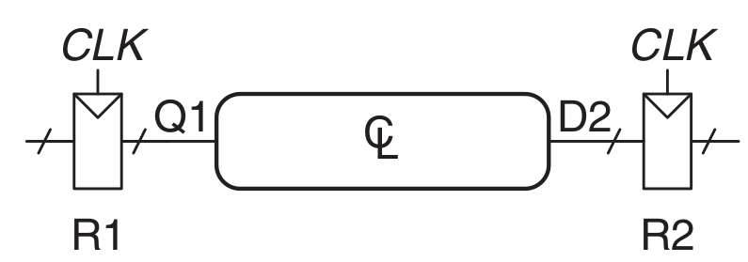
Recall: Sequential System Design
Multiple flip-flops are connected with combinational logic
Clock runs with period T_{c} (cycle time)
Must meet timing requirements for both R1 and R2!

Slide 35
Ensuring Correct Sequential Operation
Need to ensure correct input timing on R2
Specifically, D2 must be stable:
at least t_{setup} before the clock edge
at least until t_{hold} after the clock edge

Slide 36
Ensuring Correct Sequential Operation
This means there is both a minimum and maximum delay between two flip-flops
CL too fast -> R2 t_{hold} violation
CL too slow -> R2 t_{setup} violation
Potential
R2 t_{HOLD} VIOLATION!
Potential
R2 t_{SETUP} VIOLATION!
t_{HOLD}
t_{SETUP}

Slide 37
Setup Time Constraint
Safe timing depends on the maximum delay from R1 to R2
The input to R2 must be stable at least t_{setup} before the clock edge.
T_{c}

Slide 38
Setup Time Constraint
Safe timing depends on the maximum delay from R1 to R2
The input to R2 must be stable at least t_{setup} before the clock edge.
T_{c} > t_{pcq}

Slide 39
Setup Time Constraint
Safe timing depends on the maximum delay from R1 to R2
The input to R2 must be stable at least t_{setup} before the clock edge.
T_{c} > t_{pcq} + t_{pd}

Slide 40
Setup Time Constraint
Safe timing depends on the maximum delay from R1 to R2
The input to R2 must be stable at least t_{setup} before the clock edge.
T_{c} > t_{pcq} + t_{pd} + t_{setup}

Slide 41
Setup Time Constraint
Safe timing depends on the maximum delay from R1 to R2
The input to R2 must be stable at least t_{setup} before the clock edge.
Wasted work
T_{c} > t_{pcq} + t_{pd} + t_{setup}
Useful work
Sequencing overhead: amount of time wasted each cycle due to sequencing element timing requirements

Slide 42
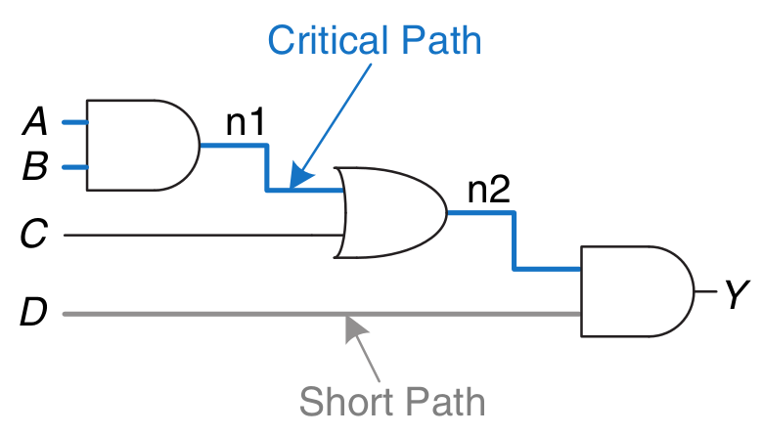
t_{setup} Constraint and Design Performance
Critical path: path with the longest t_{pd}
Overall design performance is determined by the critical path t_{pd}
Determines the minimum clock period (i.e., max operating frequency)
If the critical path is too long, the design will run slowly
If critical path is too short, each cycle will do very little useful work
i.e., most of the cycle will be wasted in sequencing overhead
T_{c} > t_{pcq} + t_{pd} + t_{setup}

Slide 43
Hold Time Constraint
Safe timing depends on the minimum delay from R1 to R2
D2 (i.e., R2 input) must be stable for at least t_{hold} after the clock edge
Must not change until t_{hold} after the clock
t_{ccq}

Slide 44
Hold Time Constraint
Safe timing depends on the minimum delay from R1 to R2
D2 (i.e., R2 input) must be stable for at least t_{hold} after the clock edge
t_{ccq} + t_{cd}

Slide 45
Hold Time Constraint
Safe timing depends on the minimum delay from R1 to R2
D2 (i.e., R2 input) must be stable for at least t_{hold} after the clock edge
t_{ccq} + t_{cd} > t_{hold}

Slide 46
Hold Time Constraint
Safe timing depends on the minimum delay from R1 to R2
D2 (i.e., R2 input) must be stable for at least t_{hold} after the clock edge
t_{ccq} + t_{cd} > t_{hold}
t_{cd} > t_{hold} - t_{ccq}
We need to have a minimum combinational delay!

Slide 47
Hold Time Constraint
Safe timing depends on the minimum delay from R1 to R2
D2 (i.e., R2 input) must be stable for at least t_{hold} after the clock edge
t_{ccq} + t_{cd} > t_{hold}
t_{cd} > t_{hold} - t_{ccq}
Does NOT depend on T_{c}!
Very hard to fix t_{hold} violations after
manufacturing- must modify circuits!

Slide 48
Sequential Timing Summary
t_{ccq} / t_{pcq} | clock-to-q delay (contamination/propagation)
t_{cd} / t_{pd} | combinational logic delay (contamination/propagation)
t_{setup} | time that FF inputs must be stable before next clock edge
t_{hold} | time that FF inputs must be stable after a clock edge
T_{c} | clock period

Slide 49
Example: Timing Analysis
Timing Characteristics
t_{ccq} = 30 ps
t_{pcq} = 50 ps
t_{setup} = 60 ps
t_{hold} = 70 ps
t_{pd} = 35 ps
t_{cd} = 25 ps
t_{pd} =
t_{cd} =
Check setup time constraints:
T_{c} > t_{pcq} + t_{pd} + t_{setup}
T_{c} >
f_{max} = 1/T_{c} =
Check hold time constraints:
t_{ccq} + t_{cd} > t_{hold} ?

Slide 50
Example: Timing Analysis
Timing Characteristics
t_{ccq} = 30 ps
t_{pcq} = 50 ps
t_{setup} = 60 ps
t_{hold} = 70 ps
t_{pd} = 35 ps
t_{cd} = 25 ps
t_{pd} = 3 x 35 ps = 105 ps
t_{cd} =
Check setup time constraints:
T_{c} > t_{pcq} + t_{pd} + t_{setup}
T_{c} >
f_{max} = 1/T_{c} =
Check hold time constraints:
t_{ccq} + t_{cd} > t_{hold} ?

Slide 51
Example: Timing Analysis
Timing Characteristics
t_{ccq} = 30 ps
t_{pcq} = 50 ps
t_{setup} = 60 ps
t_{hold} = 70 ps
t_{pd} = 35 ps
t_{cd} = 25 ps
t_{pd} = 3 x 35 ps = 105 ps
t_{cd} = 25 ps
Check setup time constraints:
T_{c} > t_{pcq} + t_{pd} + t_{setup}
T_{c} >
f_{max} = 1/T_{c} =
Check hold time constraints:
t_{ccq} + t_{cd} > t_{hold} ?

Slide 52
Example: Timing Analysis
t_{pcq}
Timing Characteristics
t_{ccq} = 30 ps
t_{pcq} = 50 ps
t_{setup} = 60 ps
t_{hold} = 70 ps
t_{pd} = 35 ps
t_{cd} = 25 ps
t_{pd}
t_{setup}
t_{pd} = 3 x 35 ps = 105 ps
t_{cd} = 25 ps
Check setup time constraints:
T_{c} > t_{pcq} + t_{pd} + t_{setup}
T_{c} > (50 + 105 + 60) ps = 215 ps
f_{max} = 1/T_{c} = 4.65 GHz
Check hold time constraints:
t_{ccq} + t_{cd} > t_{hold} ?

Slide 53
Example: Timing Analysis
Timing Characteristics
t_{ccq} = 30 ps
t_{pcq} = 50 ps
t_{setup} = 60 ps
t_{hold} = 70 ps
t_{pd} = 35 ps
t_{cd} = 25 ps
t_{ccq}
t_{cd}
t_{pd} = 3 x 35 ps = 105 ps
t_{cd} = 25 ps
Check setup time constraints:
T_{c} > t_{pcq} + t_{pd} + t_{setup}
T_{c} > (50 + 105 + 60) ps = 215 ps
f_{max} = 1/T_{c} = 4.65 GHz
Check hold time constraints:
t_{ccq} + t_{cd} > t_{hold} ?
(30 + 25) ps > 70 ps ?

Slide 54
Example: Timing Analysis
Timing Characteristics
t_{ccq} = 30 ps
t_{pcq} = 50 ps
t_{setup} = 60 ps
t_{hold} = 70 ps
t_{pd} = 35 ps
t_{cd} = 25 ps
t_{pd} = 3 x 35 ps = 105 ps
t_{cd} = 25 ps
Check setup time constraints:
T_{c} > t_{pcq} + t_{pd} + t_{setup}
T_{c} > (50 + 105 + 60) ps = 215 ps
f_{max} = 1/T_{c} = 4.65 GHz
Check hold time constraints:
t_{ccq} + t_{cd} > t_{hold} ?
(30 + 25) ps > 70 ps ?
FAIL

Slide 55
Example: Fixing Hold Time Violation
Add buffers to the short paths:
Timing Characteristics
t_{ccq} = 30 ps
t_{pcq} = 50 ps
t_{setup} = 60 ps
t_{hold} = 70 ps
t_{pd} = 35 ps
t_{cd} = 25 ps
t_{pd} =
t_{cd} =
Check setup time constraints:
T_{c} > t_{pcq} + t_{pd} + t_{setup}
T_{c} >
f_{c} =
Check hold time constraints:
t_{ccq} + t_{cd} > t_{hold} ?

Slide 56
Example: Fixing Hold Time Violation
Add buffers to the short paths:
Timing Characteristics
t_{ccq} = 30 ps
t_{pcq} = 50 ps
t_{setup} = 60 ps
t_{hold} = 70 ps
t_{pd} = 35 ps
t_{cd} = 25 ps
t_{pd} = 3 x 35 ps = 105 ps
t_{cd} = 2 x 25 ps = 50 ps
Check setup time constraints:
T_{c} > t_{pcq} + t_{pd} + t_{setup}
T_{c} >
f_{c} =
Check hold time constraints:
t_{ccq} + t_{cd} > t_{hold} ?

Slide 57
Example: Fixing Hold Time Violation
Add buffers to the short paths:
Timing Characteristics
t_{ccq} = 30 ps
t_{pcq} = 50 ps
t_{setup} = 60 ps
t_{hold} = 70 ps
t_{pd} = 35 ps
t_{cd} = 25 ps
t_{pcq}
t_{pd}
t_{setup}
t_{pd} = 3 x 35 ps = 105 ps
t_{cd} = 2 x 25 ps = 50 ps
Check setup time constraints:
T_{c} > t_{pcq} + t_{pd} + t_{setup}
T_{c} > (50 + 105 + 60) ps = 215 ps
f_{c} = 1/T_{c} = 4.65 GHz
Check hold time constraints:
t_{ccq} + t_{cd} > t_{hold} ?

Slide 58
Example: Fixing Hold Time Violation
Add buffers to the short paths:
Timing Characteristics
t_{ccq} = 30 ps
t_{pcq} = 50 ps
t_{setup} = 60 ps
t_{hold} = 70 ps
t_{pd} = 35 ps
t_{cd} = 25 ps
t_{pd} = 3 x 35 ps = 105 ps
t_{cd} = 2 x 25 ps = 50 ps
Check setup time constraints:
T_{c} > t_{pcq} + t_{pd} + t_{setup}
T_{c} > (50 + 105 + 60) ps = 215 ps
f_{c} = 1/T_{c} = 4.65 GHz
Check hold time constraints:
t_{ccq} + t_{cd} > t_{hold} ?
Note: no change
to max frequency!

Slide 59
Example: Fixing Hold Time Violation
Add buffers to the short paths:
Timing Characteristics
t_{ccq} = 30 ps
t_{pcq} = 50 ps
t_{setup} = 60 ps
t_{hold} = 70 ps
t_{pd} = 35 ps
t_{cd} = 25 ps
t_{ccq}
t_{cd}
t_{pd} = 3 x 35 ps = 105 ps
t_{cd} = 2 x 25 ps = 50 ps
Check setup time constraints:
T_{c} > t_{pcq} + t_{pd} + t_{setup}
T_{c} > (50 + 105 + 60) ps = 215 ps
f_{c} = 1/T_{c} = 4.65 GHz
Check hold time constraints:
t_{ccq} + t_{cd} > t_{hold} ?
(30 + 50) ps > 70 ps ?

Slide 60
Example: Fixing Hold Time Violation
Add buffers to the short paths:
Timing Characteristics
t_{ccq} = 30 ps
t_{pcq} = 50 ps
t_{setup} = 60 ps
t_{hold} = 70 ps
t_{pd} = 35 ps
t_{cd} = 25 ps
t_{pd} = 3 x 35 ps = 105 ps
t_{cd} = 2 x 25 ps = 50 ps
Check setup time constraints:
T_{c} > t_{pcq} + t_{pd} + t_{setup}
T_{c} > (50 + 105 + 60) ps = 215 ps
f_{c} = 1/T_{c} = 4.65 GHz
Check hold time constraints:
t_{ccq} + t_{cd} > t_{hold} ?
(30 + 50) ps > 70 ps ?
PASS

Slide 61
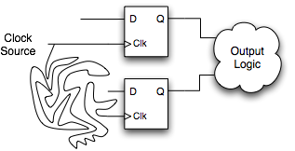
Clock Skew
To make matters worse, clocks have delay too!
The clock does not reach all parts of the chip at the same time!
Clock skew: time difference between two clock edges
CLOCK
SOURCE
A
Long, slow
clock path
B
Clock Source
Point A
Point B
clock skew

Slide 62
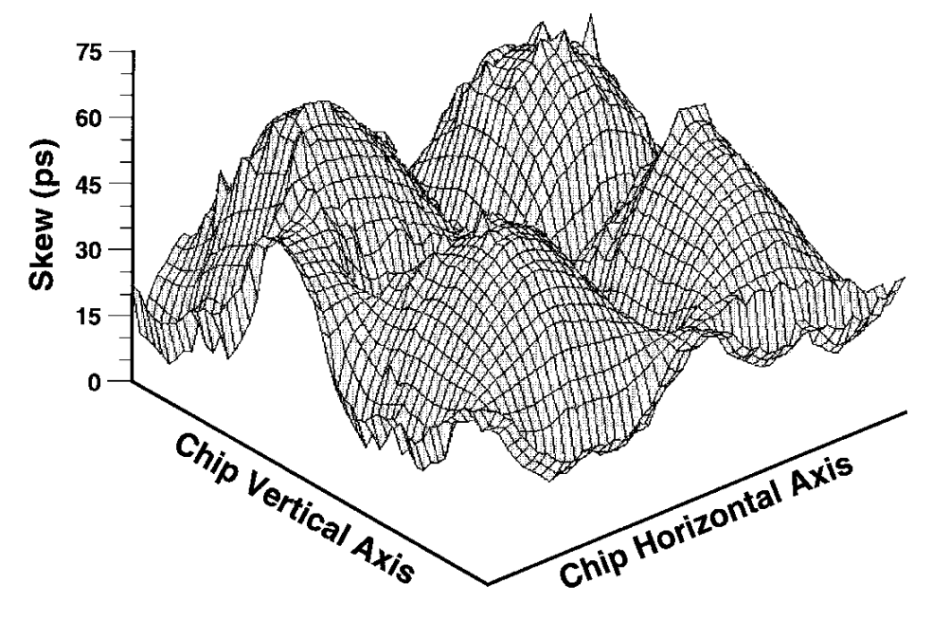
Clock Skew Example
Example of the Alpha 21264 clock skew spatial distribution
P. E. Gronowski+, "High-performance Microprocessor Design," JSSC’98.

Slide 63
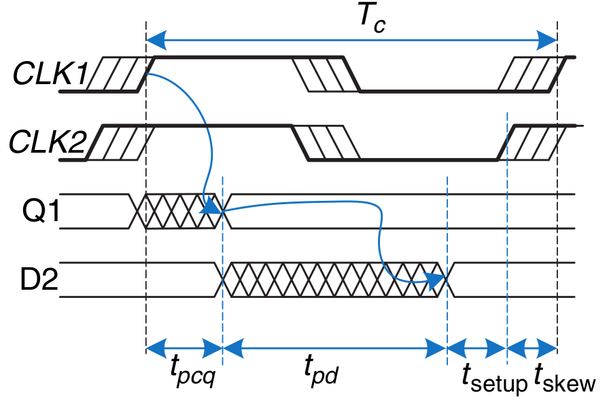
Clock Skew: Setup Time Revisited
Safe timing requires considering the worst-case skew
Clock arrives at R2 before R1
Leaves as little time as possible for the combinational logic
Signal must arrive at D2 earlier!
This effectively increases t_{setup}:
T_{c} > t_{pcq} + t_{pd} + t_{setup} + t_{skew}
T_{c} > t_{pcq} + t_{pd} + t_{setup, effective}

Slide 64
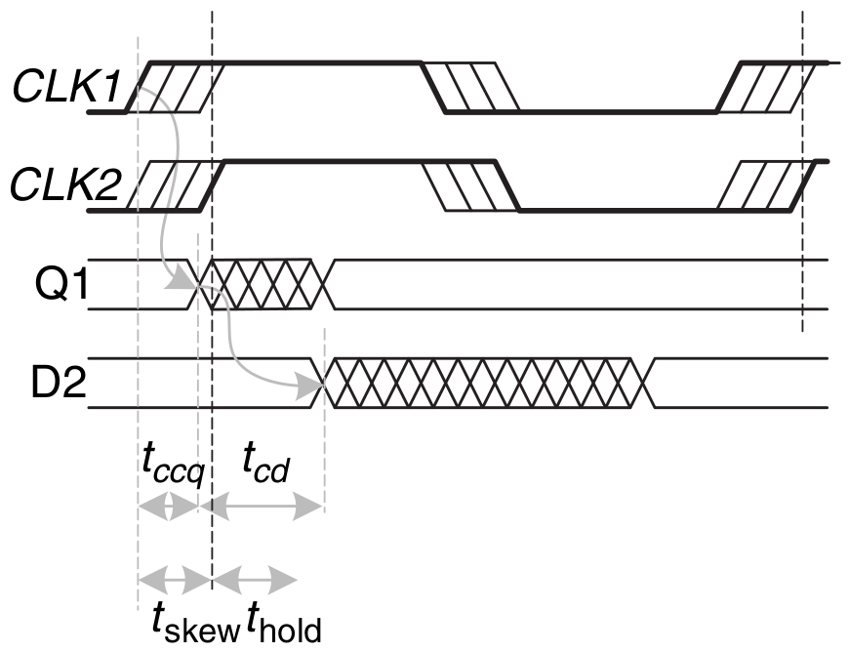
Clock Skew: Hold Time Revisited
Safe timing requires considering the worst-case skew
Clock arrives at R2 after R1
Increases the minimum required delay for the combinational logic
Signal must arrive at D2 later!
This effectively increases t_{hold}:
t_{cd} + t_{ccq} > t_{hold} + t_{skew}
t_{ccq}
t_{cd}
t_{cd} + t_{ccq} > t_{hold, effective}
t_{skew}
t_{hold}

Slide 65
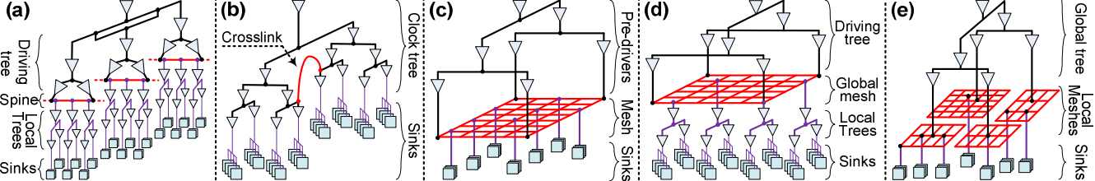
Clock Skew: Summary
Skew effectively increases both t_{setup} and t_{hold}
Increased sequencing overhead
i.e., less useful work done per cycle
Designers must keep skew to a minimum
Requires intelligent “clock network” across a chip
Goal: clock arrives at all locations at roughly the same time
Source: Abdelhadi, Ameer, et al. "Timing-driven variation-aware nonuniform clock mesh synthesis." GLSVLSI’10.

Slide 66
Part 3: Circuit Verification

Slide 67
How Do You Know That A Circuit Works?
You have designed a circuit
Is it functionally correct?
Even if it is logically correct, does the hardware meet all timing constraints?
How can you test for:
Functionality?
Timing?
Answer: simulation tools!
Formal verification tools (e.g., SAT solvers)
HDL timing simulation (e.g., Vivado)
Circuit simulation (e.g., SPICE)

Slide 68
Testing Large Digital Designs
Testing can be the most time consuming design stage
Functional correctness of all logic paths
Timing, power, etc. of all circuit elements
Unfortunately, low-level (e.g., circuit) simulation is much slower than high-level (e.g., HDL, C) simulation
Solution: we split responsibilities:
1) Check only functionality at a high level (e.g., C, HDL)
(Relatively) fast simulation time allows high code coverage
Easy to write and run tests
2) Check only timing, power, etc. at low level (e.g., circuit)
No functional testing of low-level model
Instead, test functional equivalence to high-level model
Hard, but easier than testing logical functionality at this level
Adapted from ”CMOS VLSI Design 4e”, Neil H. E. Weste and David Money Harris ©2011 Pearson

Slide 69
Testing Large Digital Designs
We have tools to handle different levels of verification
Logic synthesis tool guarantees equivalence of high-level logic and synthesized circuit-level description
Timing verification tools check all circuit timings
Design rule checks ensure that physical circuits are buildable
Our job as a logic designer is to:
Provide functional tests for logical correctness of the design
Provide timing constraints (e.g., desired operating frequency)
Tools and/or circuit engineers will decide if it can be built!
Adapted from ”CMOS VLSI Design 4e”, Neil H. E. Weste and David Money Harris ©2011 Pearson

Slide 70
Part 4: Functional Verification

Slide 71
Functional Verification
Goal: check logical correctness of the design
Physical circuit timing (e.g., t_{setup}/t_{hold}) is typically ignored
May implement simple checks to catch obvious bugs
We’ll discuss timing verification later in this lecture
There are two primary approaches
Logic simulation (e.g., C/C++/Verilog test routines)
Formal verification techniques
In this course, we will use Verilog for functional verification

Slide 72
Testbench-Based Functional Testing
Testbench: a module created specifically to test a design
Tested design is called the “device under test (DUT)”
Testbench
Test Pattern Generator
DUT
Output
Checking
Logic
Inputs
Outputs
Testbench provides inputs (test patterns) to the DUT
Hand-crafted values
Automatically generated (e.g., sequential or random values)
Testbench checks outputs of the DUT against:
Hand-crafted values
A “golden design” that is known to be bug-free

Slide 73
Testbench-Based Functional Testing
A testbench can be:
HDL code written to test other HDL modules
Circuit schematic used to test other circuit designs
The testbench is not designed for hardware synthesis!
Runs in simulation only
HDL simulator (e.g., Vivado simulator)
SPICE circuit simulation
Testbench uses simulation-only constructs
E.g., “wait 10ns”
E.g., ideal voltage/current source
Not suitable to be physically built!

Slide 74
Common Verilog Testbench Types
Testbench | Input/Output Generation | Error Checking
Simple | Manual | Manual
Self-Checking | Manual | Automatic
Automatic | Automatic | Automatic

Slide 75
Example DUT
We will walk through different types of testbenches to test a module that implements the logic function:
y = (b ∙ c) + (a ∙ b)
// performs y = ~b & ~c | a & ~b
module sillyfunction(input a, b, c,
output y);
wire b_n, c_n;
wire m1, m2;
not not_b(b_n, b);
not not_c(c_n, c);
and minterm1(m1, b_n, c_n);
and minterm2(m2, a, b_n);
or out_func(y, m1, m2);
endmodule

Slide 76
Useful Verilog Syntax for Testbenching
module example_syntax();
reg a;
// like “always” block, but runs only once at sim start
initial
begin
a = 0; // set value of reg: use blocking assignments
#10; // wait (do nothing) for 10 ns
a = 1;
$display(“printf() style message!"); // print message
end
endmodule

Slide 77
Simple Testbench

Slide 78
Simple Testbench
module testbench1(); // No inputs, outputs
reg a, b, c; // Manually assigned
wire y; // Manually checked
// instantiate device under test
sillyfunction dut (.a(a), .b(b), .c(c), .y(y) );
// apply hardcoded inputs one at a time
initial begin
a = 0; b = 0; c = 0; #10; // apply inputs, wait 10ns
c = 1; #10; // apply inputs, wait 10ns
b = 1; c = 0; #10; // etc .. etc..
c = 1; #10;
a = 1; b = 0; c = 0; #10;
end
endmodule

Slide 79
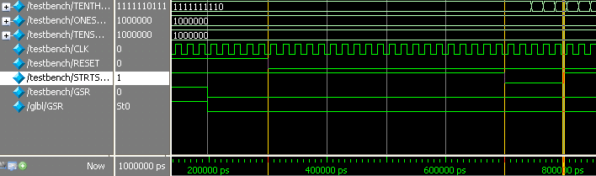
Simple Testbench: Output Checking
Most common method is to look at waveform diagrams
Thousands of signals over millions of clock cycles
Too many to just printf()!
time
Manually check that output is correct at all times
https://www.xilinx.com/support/documentation/sw_manuals/xilinx13_2/ism_c_mxe_sim_step4.htm

Slide 80
Simple Testbench
Pros:
Easy to design
Can easily test a few, specific inputs (e.g., corner cases)
Cons:
Not scalable to many test cases
Outputs must be checked manually outside of the simulation
E.g., inspecting dumped waveform signals
E.g., printf() style debugging

Slide 81
Self-Checking Testbench

Slide 82
Self-Checking Testbench
module testbench2();
reg a, b, c;
wire y;
sillyfunction dut(.a(a), .b(b), .c(c), .y(y));
initial begin
a = 0; b = 0; c = 0; #10; // apply input, wait 10ns
if (y !== 1) $display("000 failed."); // check result
c = 1; #10;
if (y !== 0) $display("001 failed.");
b = 1; c = 0; #10;
if (y !== 0) $display("010 failed.");
end
endmodule

Slide 83
Self-Checking Testbench
Pros:
Still easy to design
Still easy to test a few, specific inputs (e.g., corner cases)
Simulator will print whenever an error occurs
Cons:
Still not scalable to millions of test cases
Easy to make an error in hardcoded values
You make just as many errors writing a testbench as actual code
Hard to debug whether an issue is in the testbench or in the DUT

Slide 84
Self-Checking Testbench using Testvectors
Write testvector file
List of inputs and expected outputs
Can create vectors manually or automatically using an already verified, simpler “golden model” (more on this later)
Example file:
$ cat testvectors.tv
000_1
001_0
010_0
011_0
100_1
101_1
110_0
111_0
…
Format: input_output

Slide 85
Testbench with Testvectors Design
Use a “clock signal” for assigning inputs, reading outputs
Test one testvector each “clock cycle”
Clock cycle
Apply input
on rising edge
Check outputs on falling edge
Note: “clock signal” simply separates inputs from outputs
Allows us to observe the inputs/outputs in waveform diagrams
Not used for checking physical circuit timing (e.g., t_{setup}/t_{hold})
We’ll discuss circuit timing verification later in this lecture

Slide 86
Testbench Example (1/5): Signal Declarations
Declare signals to hold internal state
module testbench3();
reg clk, reset; // clock and reset are internal
reg a, b, c, yexpected; // values from testvectors
wire y; // output of circuit
reg [31:0] vectornum, errors; // bookkeeping variables
reg [3:0] testvectors[10000:0];// array of testvectors
// instantiate device under test
sillyfunction dut(.a(a), .b(b), .c(c), .y(y) );
H&H Section 4.9, Example 4.39

Slide 87
Testbench Example (2/5): Clock Generation
// generate clock
always // no sensitivity list, so it always executes
begin
clk = 1; #5; clk = 0; #5; // 10ns period
end

Slide 88
Testbench Example (3/5): Read Testvectors into Array
// at start of test, load vectors and pulse reset
initial // Only executes once
begin
$readmemb("example.tv", testvectors); // Read vectors
vectornum = 0; errors = 0; // Initialize
reset = 1; #27; reset = 0; // Apply reset wait
end
// Note: $readmemh reads testvector files written in
// hexadecimal

Slide 89
Testbench Example (4/5): Assign Inputs/Outputs
// apply test vectors on rising edge of clk
always @(posedge clk)
begin
{a, b, c, yexpected} = testvectors[vectornum];
end
Apply {a, b, c} inputs on the rising edge of the clock
Get yexpected for checking the output on the falling edge
Rising/falling edges are chosen only by convention
You can use any part of the clock signal
Your H+H textbook uses this convention

Slide 90
Testbench Example (5/5): Check Outputs
always @(negedge clk)
begin
if (~reset) // don’t test during reset
begin
if (y !== yexpected)
begin
$display("Error: inputs = %b", {a, b, c});
$display(" outputs = %b (%b exp)",y,yexpected);
errors = errors + 1;
end
// increment array index and read next testvector
vectornum = vectornum + 1;
if (testvectors[vectornum] === 4'bx)
begin
$display("%d tests completed with %d errors",
vectornum, errors);
$finish; // End simulation
end
end
end

Slide 91
Self-Checking Testbench with Testvectors
Pros:
Still easy to design
Still easy to test a few, specific inputs (e.g., corner cases)
Simulator will print whenever an error occurs
No need to change hardcoded values for different tests
Cons:
May be error-prone depending on source of testvectors
More scalable, but still limited by reading a file
Might have many more combinational paths to test than will fit in memory

Slide 92
Automatic Testbench

Slide 93
Golden Models
A golden model represents the ideal circuit behavior
Must be developed, and might be difficult to write
Can be done in C, Perl, Python, Matlab or even in Verilog
For our example circuit:
module golden_model(input a, b, c,
output y);
assign y = ~b & ~c | a & ~b;// high-level abstraction
endmodule
Simpler than our earlier gate-level description
Golden model is usually easier to design and understand
Golden model is much easier to verify

Slide 94
Automatic Testbench
The DUT output is compared against the golden model
Testbench
Inputs
Outputs
DUT
Check Equality
Test Pattern Generation
Golden Model
Challenge: need to generate inputs to the designs
Sequential values to cover the entire input space?
Random values?

Slide 95
Automatic Testbench: Code
module testbench1();
... // variable declarations, clock, etc.
// instantiate device under test
sillyfunction dut (a, b, c, y_dut);
golden_model gold (a, b, c, y_gold);
// instantiate test pattern generator
test_pattern_generator tgen (a, b, c, clk);
// check if y_dut is ever not equal to y_gold
always @(negedge clk)
begin
if(y_dut !== y_gold)
$display(...)
end
endmodule

Slide 96
Automatic Testbench
Pros:
Output checking is fully automated
Could even compare timing using a golden timing model
Highly scalable to as much simulation time as is feasible
Leads to high coverage of the input space
Better separation of roles
Separate designers can work on the DUT and the golden model
DUT testing engineer can focus on important test cases instead of output checking
Cons:
Creating a correct golden model may be (very) difficult
Coming up with good testing inputs may be difficult

Slide 97
However, Even with Automatic Testing…
How long would it take to test a 32-bit adder?
In such an adder there are 64 inputs = 2⁶⁴ possible inputs
If you test one input in 1ns, you can test 10⁹ inputs per second
or 8.64 x 10¹⁴ inputs per day
or 3.15 x 10¹⁷ inputs per year
we would still need 58.5 years to test all possibilities
Brute force testing is not feasible for most circuits!
Need to prune the overall testing space
E.g., formal verification methods, choosing ‘important cases’
Verification is a hard problem

Slide 98
Part 5: Timing Verification

Slide 99
Timing Verification Approaches
High-level simulation (e.g., C, Verilog)
Can model timing using “#x” statements in the DUT
Useful for hierarchical modeling
Insert delays in FF’s, basic gates, memories, etc.
High level design will have some notion of timing
Usually not as accurate as real circuit timing
Circuit-level timing verification
Need to first synthesize your design to actual circuits
No one general approach- very design flow specific
Your FPGA/ASIC/etc. technology has special tool(s) for this
E.g., Xilinx Vivado (what you’re using in lab)
E.g., Synopsys/Cadence Tools (for VLSI design)

Slide 100
The Good News
Tools will try to meet timing for you!
Setup times, hold times
Clock skews
…
They usually provide a ‘timing report’ or ‘timing summary’
Worst-case delay paths
Maximum operation frequency
Any timing errors that were found

Slide 101
The Bad News
The tool can fail to find a solution
Desired clock frequency is too aggressive
Can result in setup time violation on a particularly long path
Too much logic on clock paths
Introduces excessive clock skew
Timing issues with asynchronous logic
The tool will provide (hopefully) helpful errors
Reports will contain paths that failed to meet timing
Gives a place from where to start debugging
Q: How can we fix timing errors?

Slide 102
Meeting Timing Constraints
Unfortunately, this is often a manual, iterative process
Meeting strict timing constraints (e.g., high performance designs) can be tedious
Can try synthesis/place-and-route with different options
Different random seeds
Manually provided hints for place-and-route
Can manually optimize the reported problem paths
Simplify complicated logic
Split up long combinational logic paths
Recall: fix hold time violations by adding more logic!

Slide 103
Meeting Timing Constraints: Principles
Let’s go back to the fundamentals
Clock cycle time is determine by the maximum logic delay we can accommodate without violating timing constraints
Good design principles
Critical path design: Minimize the maximum logic delay
→ Maximizes performance
Balanced design: Balance maximum logic delays across different parts of a system (i.e., between different pairs of flip flops)
→ No bottlenecks + minimizes wasted time
Bread and butter design: Optimize for the common case, but make sure non-common-cases do not overwhelm the design
→ Maximizes performance for realistic cases

Slide 104
Lecture Summary
Timing in combinational circuits
Propagation delay and contamination delay
Glitches
Timing in sequential circuits
Setup time and hold time
Determining how fast a circuit can operate
Circuit Verification
How to make sure a circuit works correctly
Functional verification
Timing verification

Slide 105
Digital Design & Computer Arch. Lecture 8: Timing and Verification
Prof. Onur Mutlu
ETH Zürich
Spring 2020
13 March 2020

